Slide 1
Fig:largepg
Hidden Fluent
Activity
Agent Action
Use Computer
Get Water
Drink Water
Inferred Value
Dispense Water
Causal Link
Trigger
Sit Down
Move Mouse
Use Keyboard
Stand Up
Get Cup
Approach Dispenser
* Prediction: SCREEN SAVER
Computer Status
ASLEEP
AWAKE
ASLEEP
Monitor Display
OFF
ON
OFF
Monitor Power
POWERED
Cup Status
LESS FULL
MORE FULL
LESS FULL
Agent Thirst
THIRSTY
NOT THIRSTY
Time (not drawn to scale)

Slide 2
Fig:consistency

Slide 3
Fig:jointinference
ODO: demo picture of joint inference. T $\to$ C, C $\to$ T. \bigskip T: agent touches region on wall, light goes on $\to$ C: flipping light switch causes light on $\to$ T: action was touching light switch, region is light switch
Temporally Local Causal Parsing
Beam Search
Video
Temporal Parsing
Adapted Viterbi Algorithm
Dynamic Causal Parsing

Slide 4
a) Screen Saver ON
b) Agent NOT THIRSTY

Slide 5
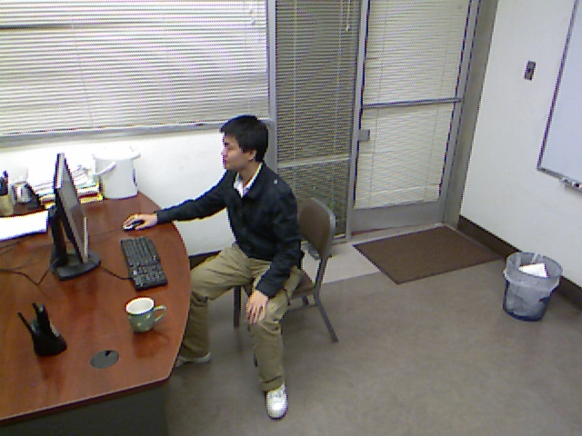
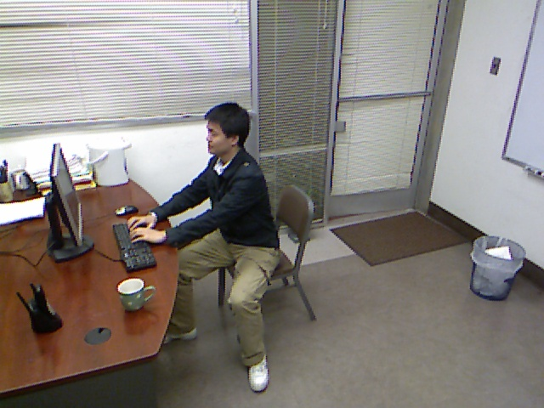
Fig:causalaog
a) Causal-AOG
F = Display
F₁ = Monitor
F₂ = Computer
F(t) = ON
Fluent
Action
Inertial Action
Fluent Transit
F₂(t) = AWAKE
F₁(t) = POWERED
Monitor On
Computer On
Monitor Powered
On Inertial
Change
Off
Move Mouse
Change 2
Off
Kyboard
Powered Inertial
Change
Off
Power button
ST-Relations
F₂(t-1) = AWAKE
F₂(t-1) = ASLEEP
F₂(t-1) = ASLEEP
Notes:
View 3, frame 447, frame 514. (fit to height, then crop to width)

Slide 6
Fig:causalpg
Fluent
b) Causal-PG
…
Pre-Conditions
Cause
Use Keyboard(t-1, t₂)
Causal-PG
Action
Agent Action
…
Composition
ST-Relations
…
Actions
…
F₂(t) = AWAKE
Fluent
Computer
F₂(t-1) = ASLEEP
Display
F (t) = ON
F(t-1) = OFF
F₁(t-1) = POWERED
F₁(t) = POWERED
Monitor
t – 1
t
Time

Slide 7
Fig:flowchart
TODO: check on save and icon. Mac ppt grey out icon at top if not saved
Input from ST-AOG
Matching on the C-AOG
Forward/Backward Matching/Completion
a) Input: Video/XML
b) Event Parsing
c) Causal Parsing
d) Causal Completion
Agent Actions
Action
Drink
Hidden Fluent
Use Keyboard
Screensaver
Fluents
Causal Link
Monitor
ON
UNKNOWN
OFF
Agent
THIRSTY
UNKNOWN
NOT
Time
Time
Time
Notes:
View 3, frame 514.

Slide 8
Fig:transitions
{ pg_{OFF→ON} }
a) Transition Between States
b) Transition Between Parse Graphs
c) Duration Histogram
p₂
F = ON
1 – p₂
p₁
p₄
1 – p₃
F = OFF
p₃
Notes:
2012-03-17_17-20-07.asf (ends approx 2:00). Note: add 20% to brightness.

Slide 9
Fig:inferencealgorithm
Time
t – 1
t

Slide 10
Fig:viterbialgorithm
t–1
t
t
Important Time Points
ST-Input
t–1
t
t
Important Time Points
ST-Input

Slide 11
Fig:lightdetections
No Action Detected!
ST Detections
1st Class of Interpretations
2nd Class of Interpretations
* Touch Switch
* Touch Switch
Frame Number
(not drawn to scale)
1345
1347
1348
1352
10333
10335
11877
11881
11941
11949

Slide 13
Fig:causingactions

Slide 14
Fig:cpgovertime

Slide 15
Monitor On
On inertial
On due to mouse movement
On keyboard
On power
Computer Awake
F(t-1) = OFF
Push Monitor Power Button
F(t-1) = OFF
Monitor Powered
Monitor On
Computer On
Monitor Powered
On Inertial
Change
Off
Move Mouse
Change 2
Off
Kyboard
Powered Inertial
Change
Off
Power button
Fluent Consequence
Cause
Open
Open Inertial
Open Outside
Open Inside
Unlock
Push
Unlock
Pull
Open
Open Inertial
Open Outside
Open Inside
Unlock
Push
Unlock
Pull
INUS Conditions

Slide 16
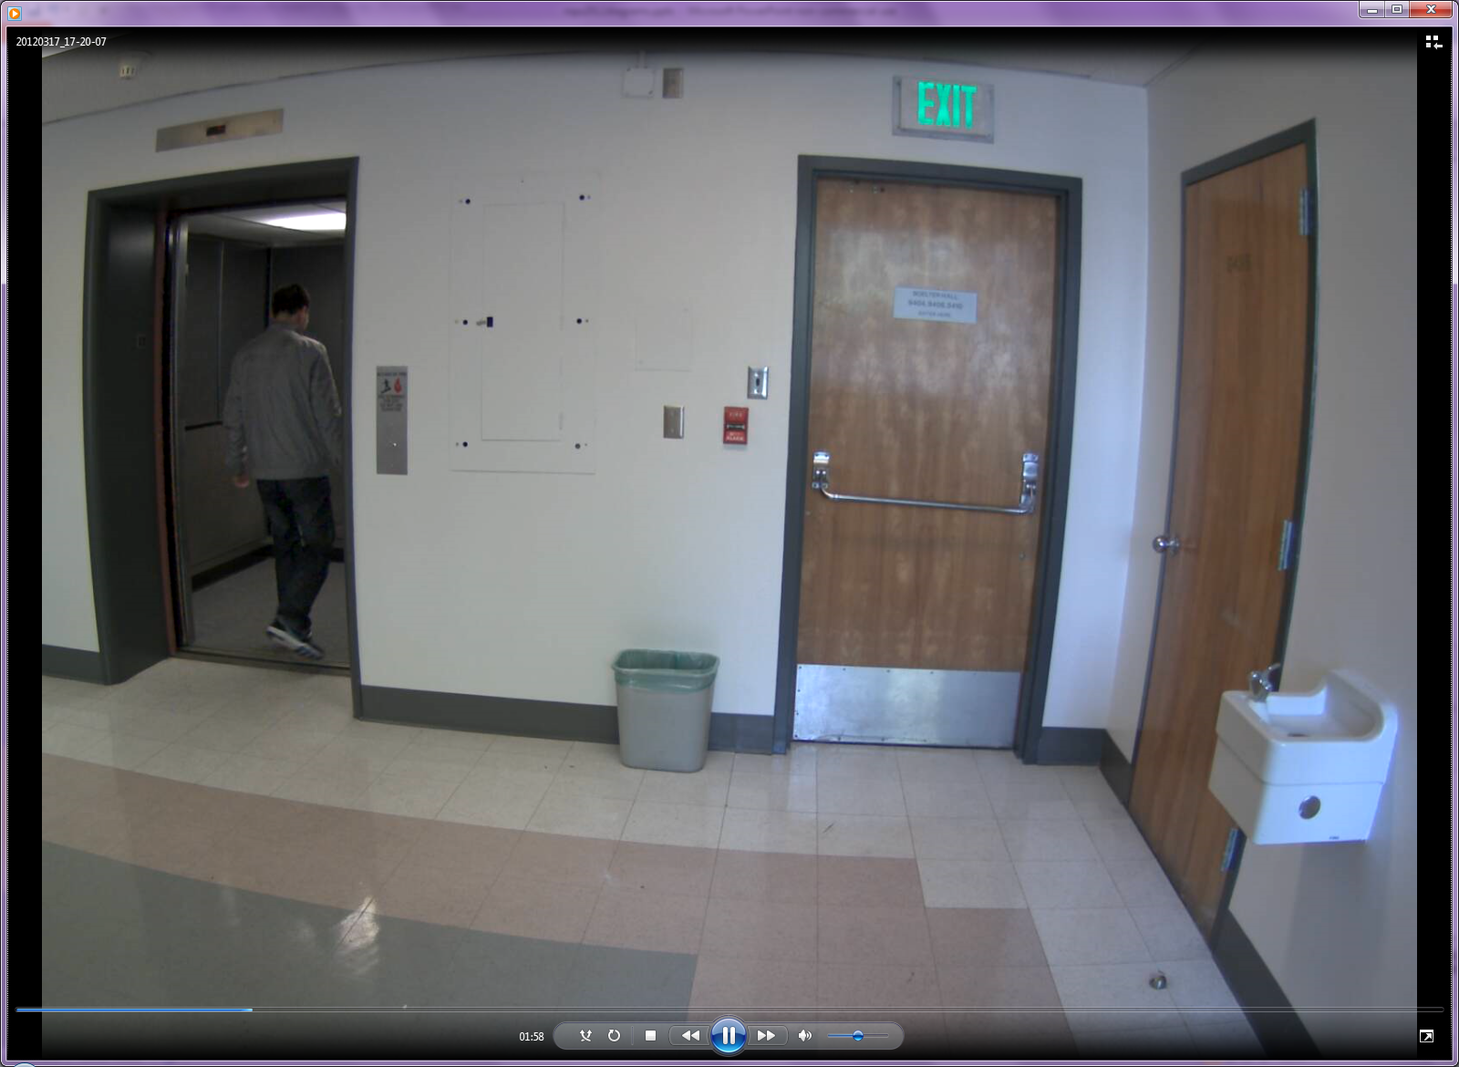
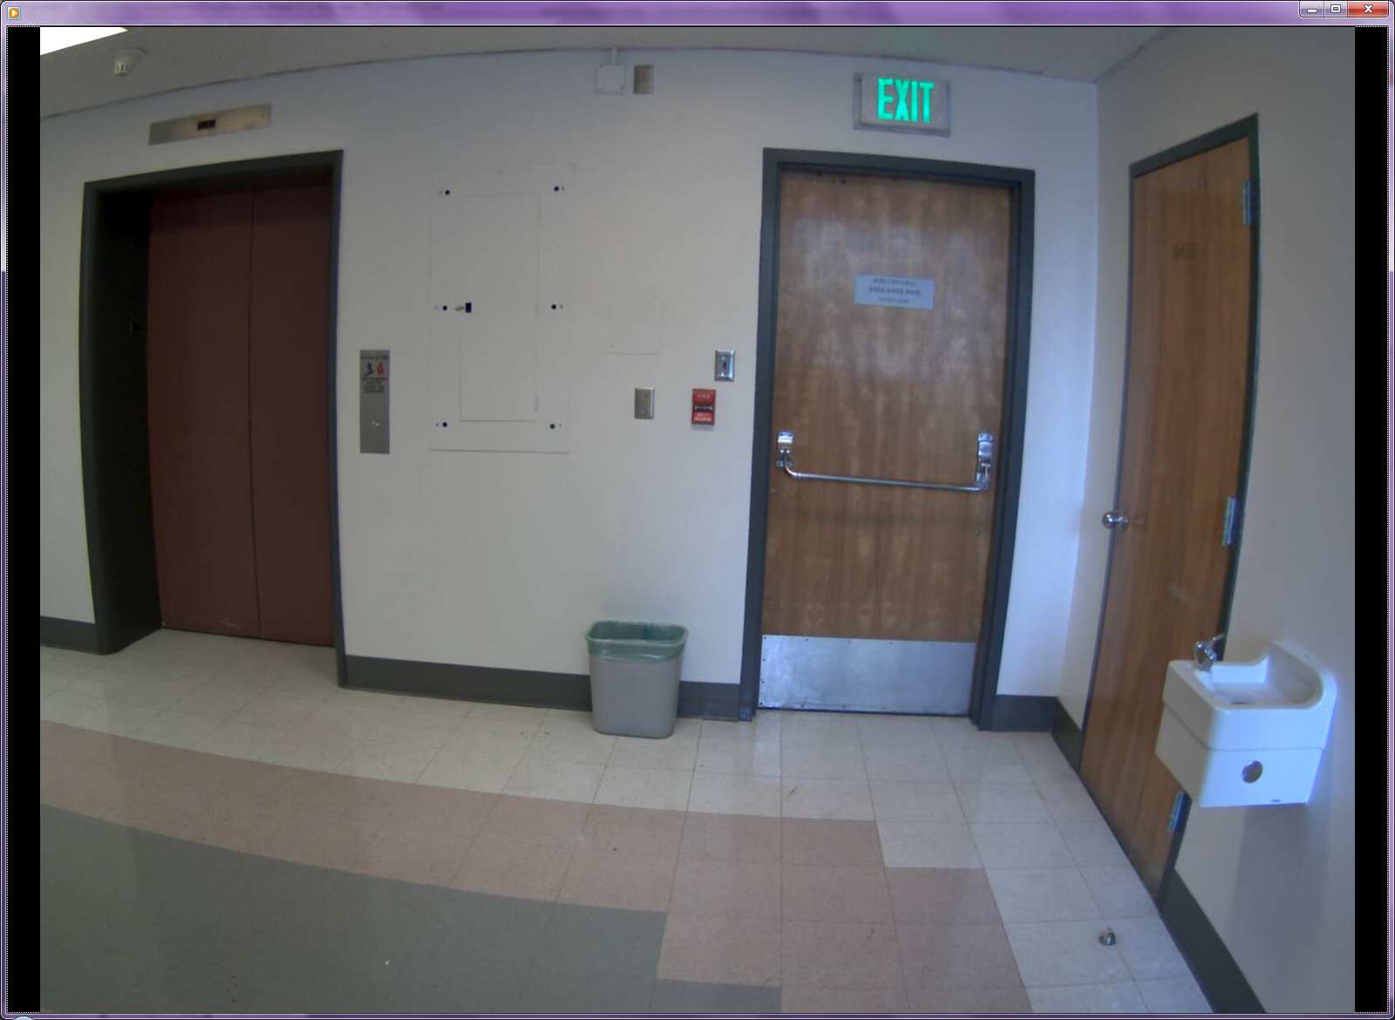
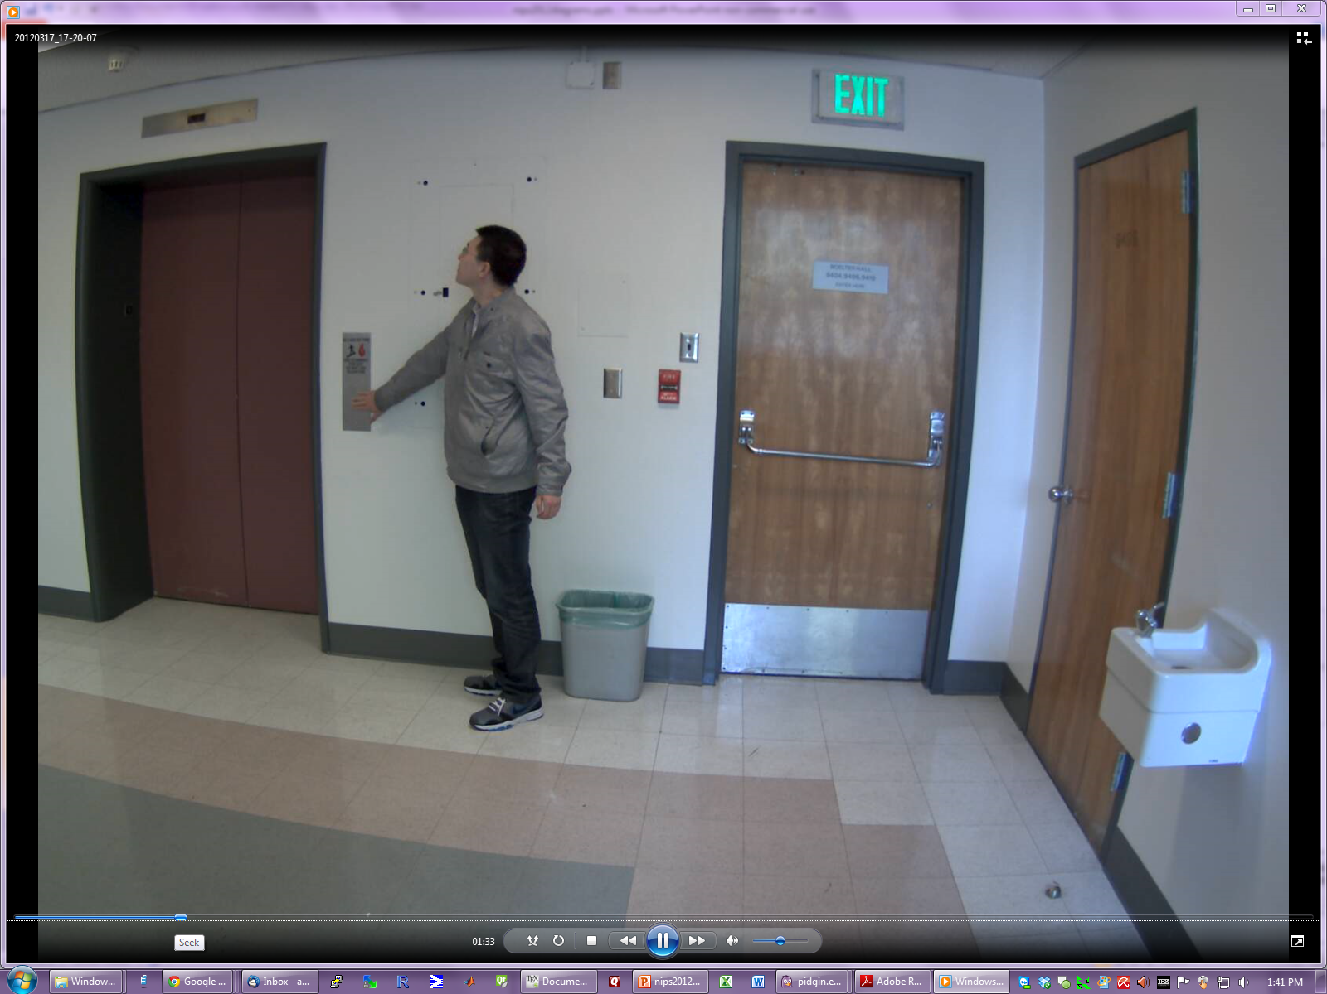
Notes:
2012-03-17_17-20-07.asf (ends approx 2:00)

Slide 17
Fig:fluentlist
 | Office | Hallway
Hidden | Trashcan {MORE FULL, LESS FULL} Monitor {ON, OFF} Computer Power {ON, OFF, ASLEEP} Phone {ACTIVE, NOT}, {RINGING, NOT} Cup {MORE FULL, LESS FULL} Water Stream {ON/OFF} | Trashcan {MORE FULL, LESS FULL} Water Stream {ON, OFF} Phone {ACTIVE, STANDBY}
Observable | Light {ON, OFF} Door {OPEN, CLOSED} | Door {OPEN, CLOSED} Elevator Door {OPEN, CLOSED} Light {ON, OFF}
Agent | Thirst {THIRSTY, SATIATED} | Thirst {THIRSTY, SATIATED}
Agent Goals | Compute Drink Get Water Dispose, Retrieve Trash Answer phone | Talk on Phone Drink Enter, Leave Room Enter, Leave Floor Dispose, Retrieve Trash

Slide 18
*** Maybe if move mouse first, computer was asleep (monitor ON/OFF)
} (no delay holding phone, therefore rang)

Slide 19
Fig:experimentoutput

Slide 20
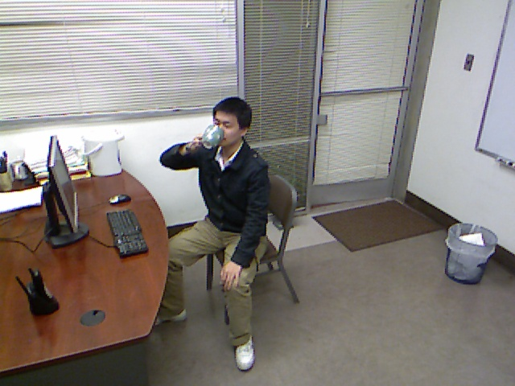
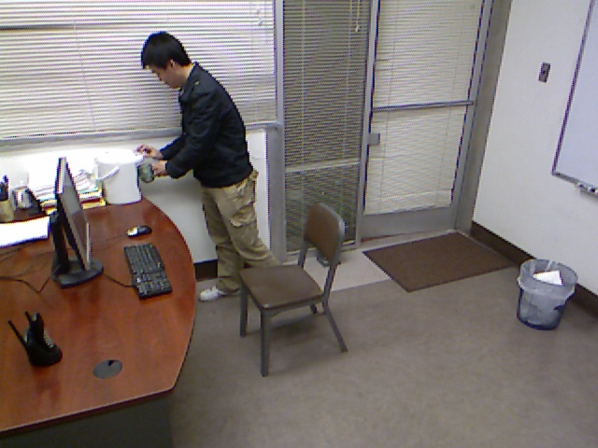
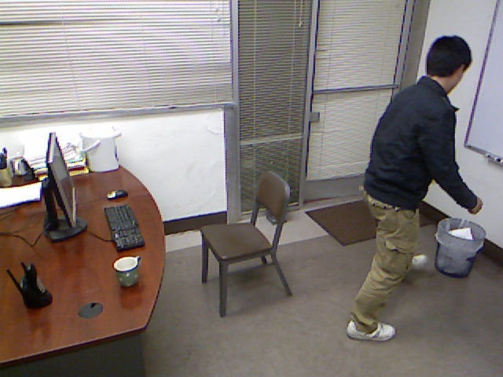
Fig:toplevelcaog
Cup = Less Full
Cup = More Full
Notes:
From view 3: Frame 762, 1217 (and one of the trash ones).

Slide 21
Fig:fluentchange
Mind
Thirst Status
Agent Action
Thirsty
Not Thirsty
Agent Action
S (T-AOG)
Hidden Fluent
Causal Link
Fluents
Get Water
Drink
Water
Cup Status
Time
Lacks Some Water
Has Water
Lacks Some Water

Slide 22
Fig:causalpg
Causal-PG
Fluent
Fluent Status
Cause
Pre-Conditions
Actions
Action
…
Composition
…
…
…
Fluent
ST-Relations

Slide 23
Fig:causalpg
Causal-PG
Fluent Status
…
…
Pre-Conditions
Actions

Slide 24
Fig:flowchart
TODO: check on save and icon. Mac ppt grey out icon at top if not saved
Input from ST-AOG
Matching on the C-AOG
Forward/Backward Matching/Completion
Input: Video
ST-Parsing
Causal Parsing
Causal Completion
Agent Actions
Action
Fluent
Hidden Fluent
ON
ON
ON
Fluents
Causal Link
OFF
OFF
OFF
ON
UNKNOWN
ON
ON
OFF
OFF
OFF
Time
Time
Time

Slide 25
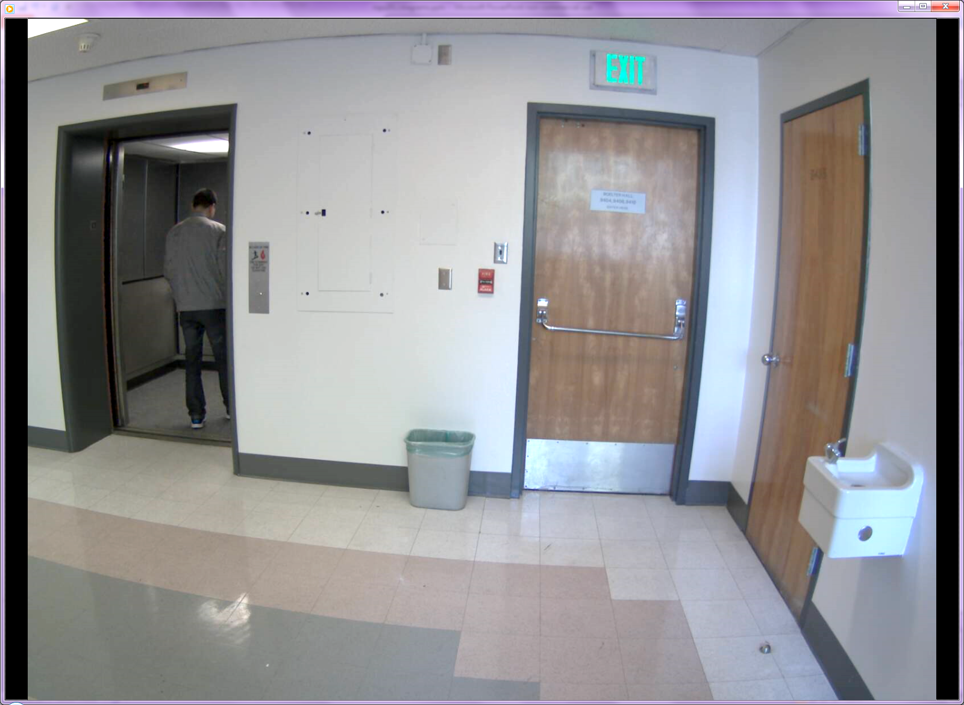
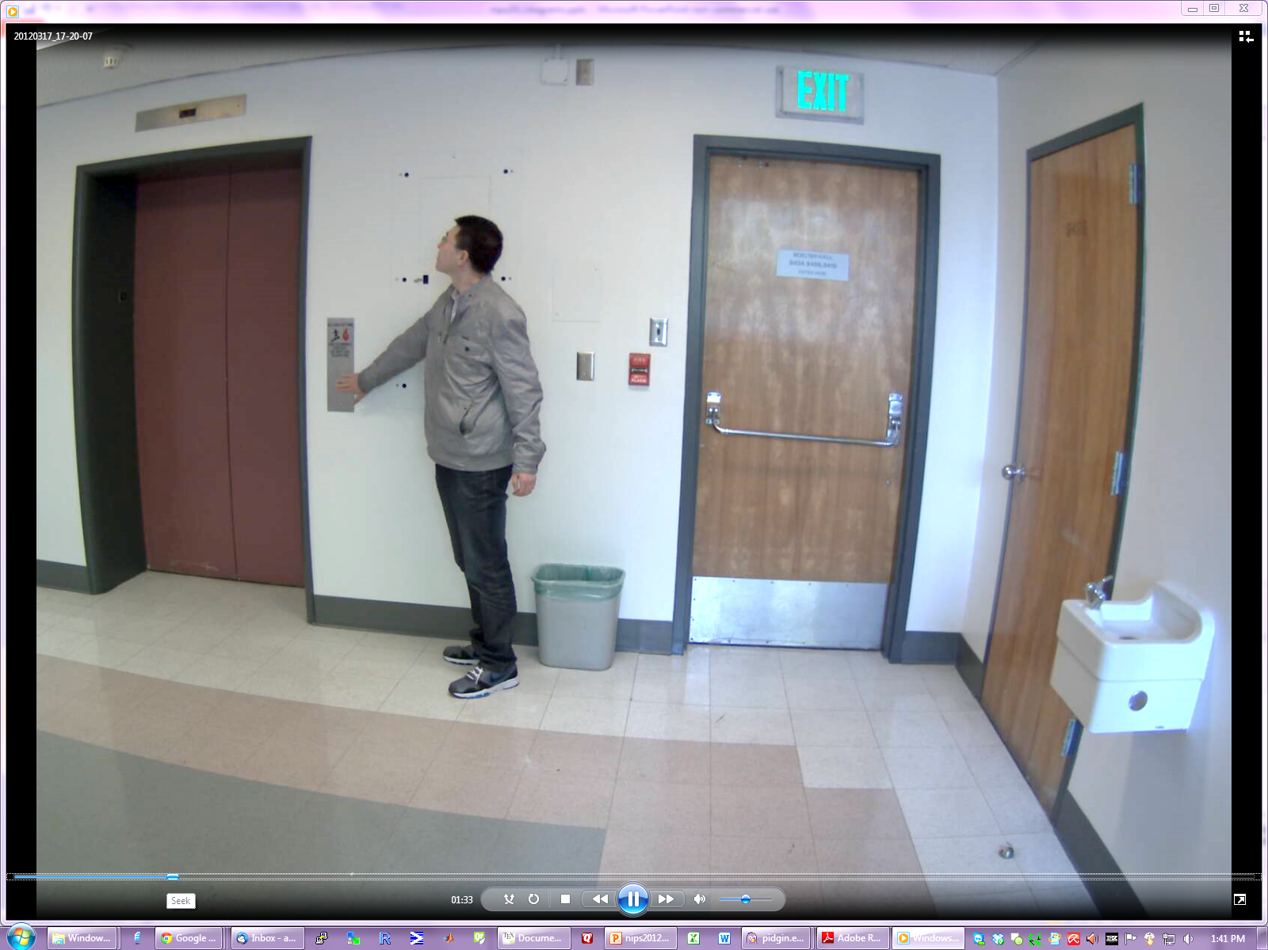
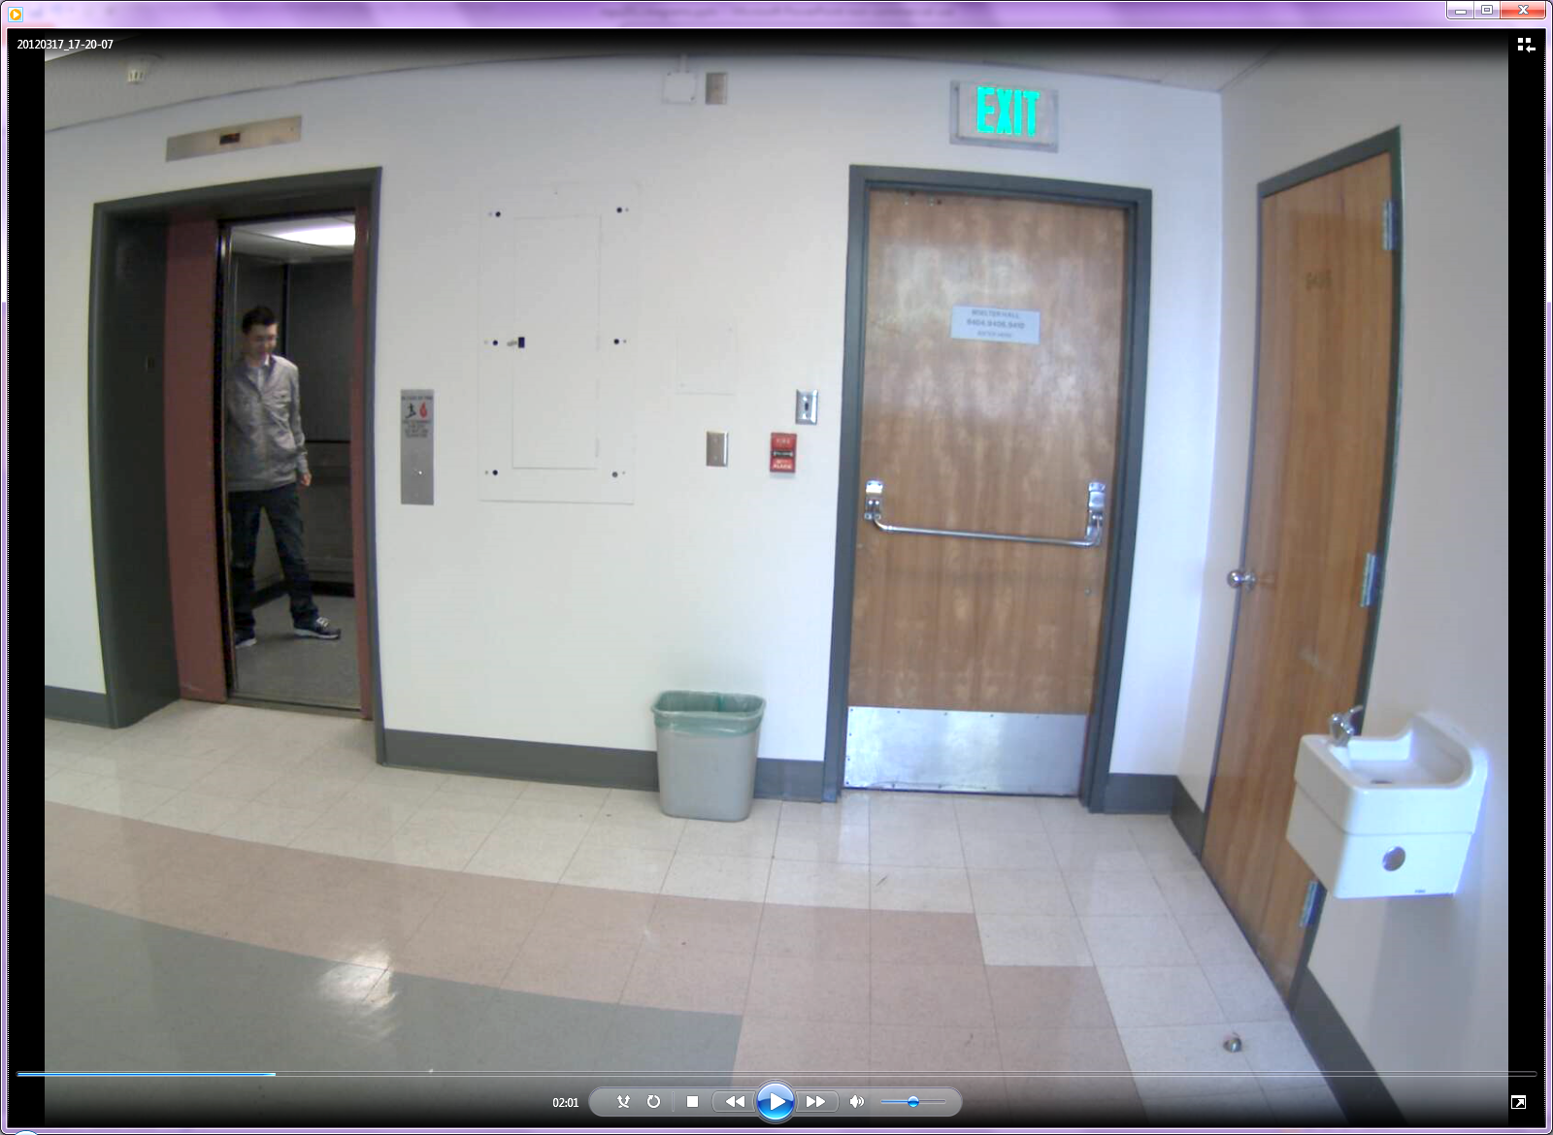
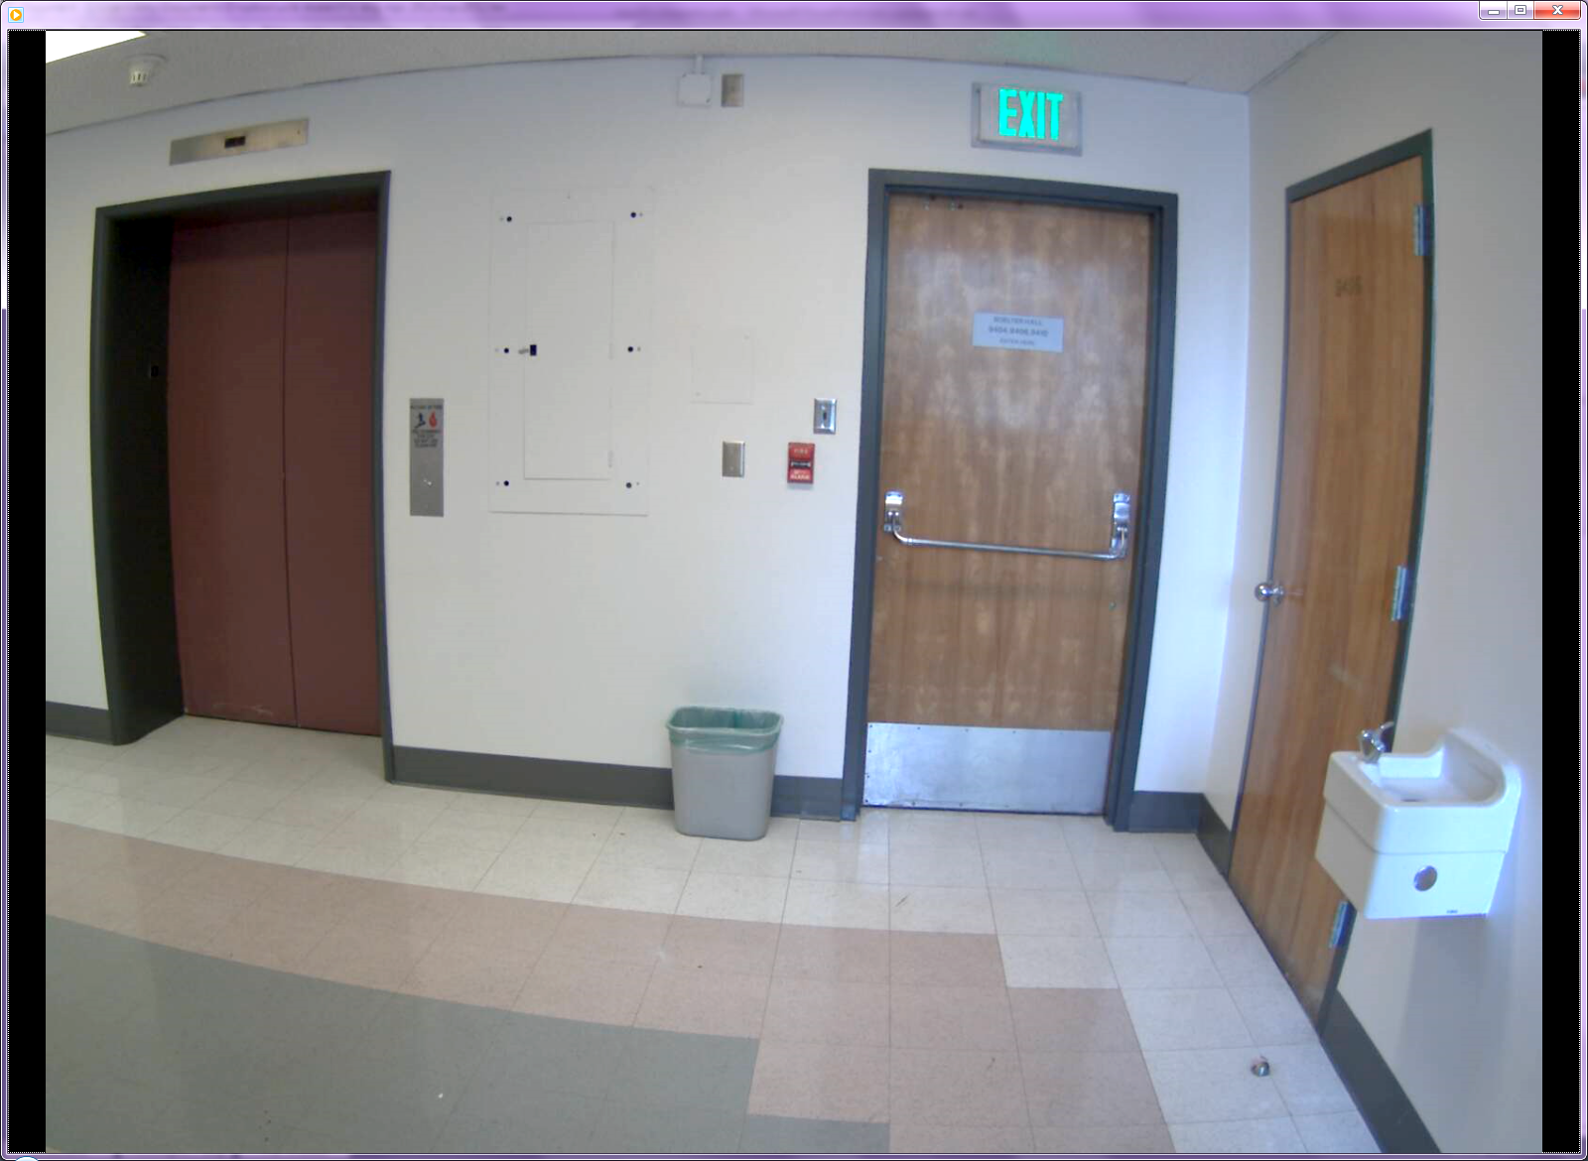
Fig:transitions
{ pg_{OFF→ON} }
{ pg : F(t) = ON,
F(t-1)=ON }
{ pg : F(t) = OFF,
F(t-1)=ON }
P₂ (.)
P₁(.)
1 – P₂ (.)
1 – P₁ (.)
1 – P₄ (.)
1 – P₃ (.)
P₄ (.)
P₃ (.)
{ pg : F(t) = ON,
F(t-1)=OFF }
{ pg : F(t) = OFF,
F(t-1)=OFF }
Notes:
2012-03-17_17-20-07.asf (ends approx 2:00). Note: add 20% to brightness.

